Slide 1
LightRec: A Memory and Search-Efficient Recommenders System
ADVISOR:JIA-LING KOH
SOURCE:WWW ‘20
SPEAKER:LI-WEI LIU
DATA:2021/3/22

Slide 2
OUTLINE
Introduction
Method
Experiment
Conclusion

Slide 3
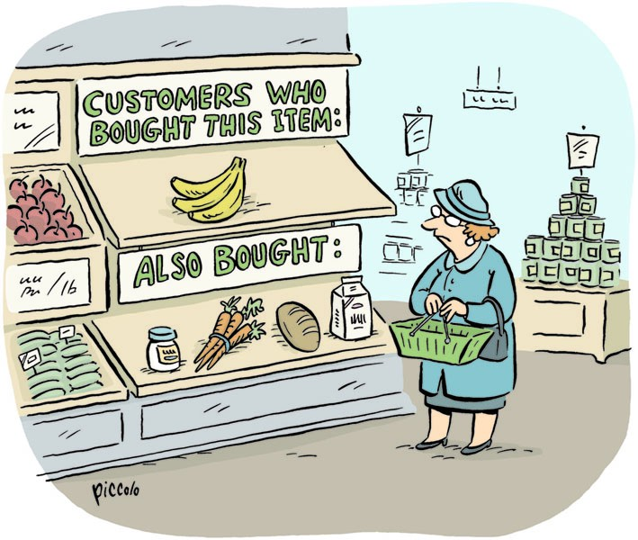
INTRODUCTION Recommenders System(only ranking)
In recommenders system,we may have many item to represent!
Goal→ LightRec
Reduces memory cost of item representation & improve efficiency for ranking.
Notes:
圖為推薦系統示意圖
在推薦系統的任務上，會需要給許多的item高維度的表示法，會非常消耗記憶體，甚至增加計算ranking的時間
目標: 學習一種架構，使得編碼item representation 時可以減少大量的記憶體消耗及增加效能

Slide 4
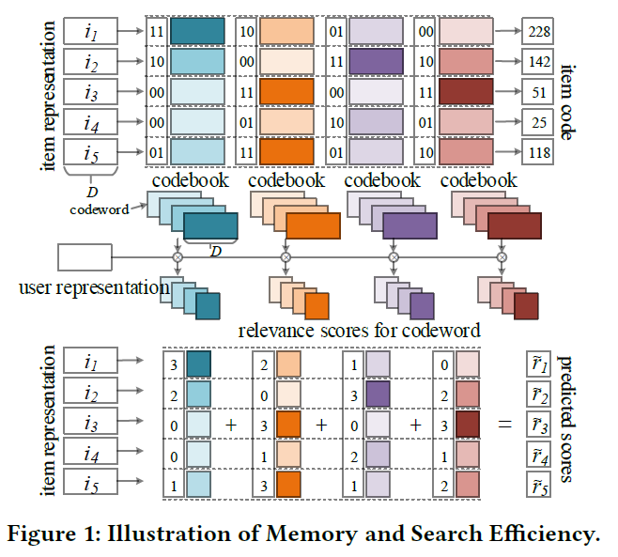
INTRODUCTION Backbone of LightRec
4 codewords in each of 4 codebooks
codeword:
Binary indicator for item representation.
codebook:
Learn diversified information
between any 2 codebooks.
Notes:
codebook會用學的方式，學習不同的資訊給item representatio去組成codeword

Slide 5
OUTLINE
Introduction
Method
Experiment
Conclusion

Slide 6
FRAMEWORK

Slide 7
METHOD Initial representation
Input : user id & item id (user-item review).
User Encoding & Item Encoding :
simple embedding module
User representation MLP:
To learn distinct user representations
Notes:
有加user-item review embedding的實驗再講
User representation MLP:對每個使用者學習2個不同的表示法，在損失函數學習時會用到(作者認為效果比使用單一的好)

Slide 8
METHOD representd to codewords
Inner product
Similarity function
Find the most similar codeword of each codebook
relevance score
Loss (BPR loss):
Notes:
Bayesian Personalized Ranking(BPR) 黑板上畫個圖解釋一下

Slide 9
METHOD back-propagation
e_{i} = one-hot(w_{i} )
temperature T = 0.9
Notes:
T是>0的數，越接近0越接近softmax出來的機率分布，越大則越平滑
總結一下到這邊的內容!!!!!!!

Slide 10
FRAMEWORK

Slide 11
METHOD Recurrent Composite Encoding
→ Can be intuitively implemented by RNN
x¹ = q is item representation
Notes:
有加user-item review embedding的實驗再講
User representation MLP:對每個使用者學習2個不同的表示法，在損失函數學習時會用到(作者認為效果比使用單一的好)

Slide 12
FRAMEWORK

Slide 13
METHOD Knowledge Distillation
loss:
Loss (BPR loss):
Output of recurrent composite encoding
User representation(MLP)
temperature T = 0.5
Notes:
L IP-KD : 由於relevance score也是用user跟item inner product的概念計算，所以這裡加入P1、P2做inner product

Slide 14
OUTLINE
Introduction
Method
Experiment
Conclusion

Slide 15
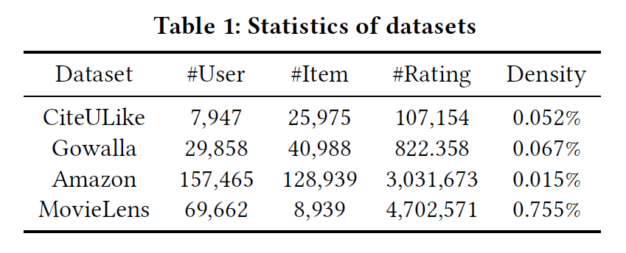
EXPERIMENT DataSets
Notes:
1.在Amazon & MovieLens ，rating>3的為positive
2.少於3個rating的user過濾掉

Slide 16
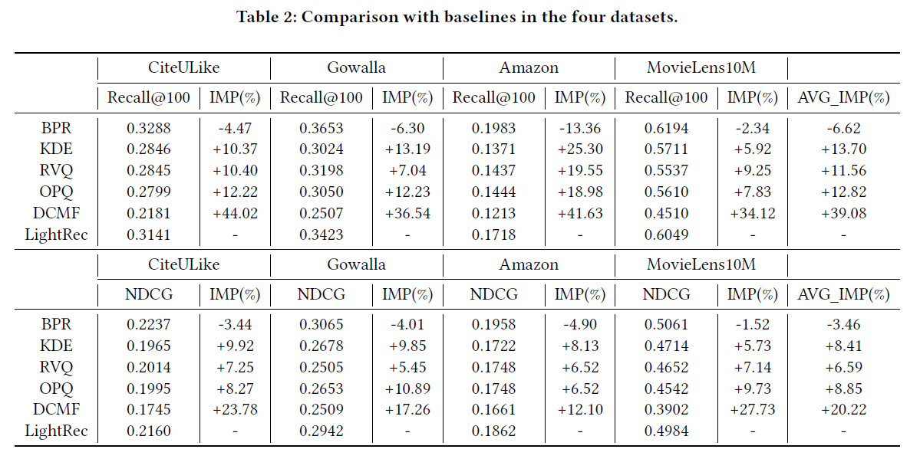
EXPERIMENT Comparison with Baselines
Notes:
值得提的，在較密集的資料集可以發現跟其他model比效果比較好，因為LIghtRec在不稀疏的資料集表現比較好

Slide 17
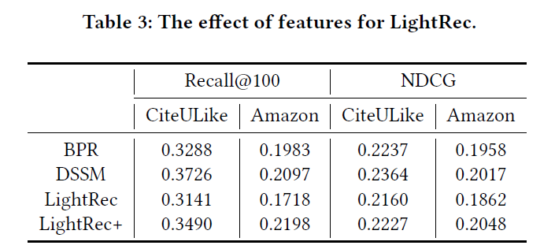
EXPERIMENT Effectiveness of Side Textual Information
Notes:
review embedding接在item representation後面
DSSM在sparse的資料集表現較LightRec好

Slide 18
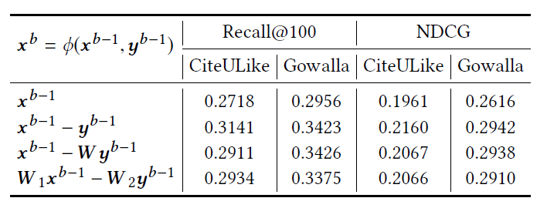
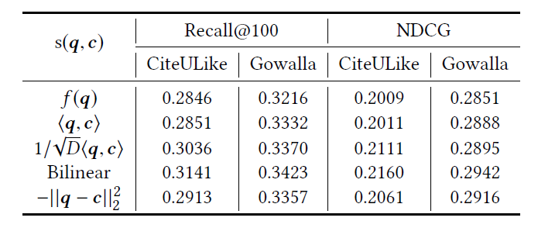
EXPERIMENT Effectiveness Study

Slide 19
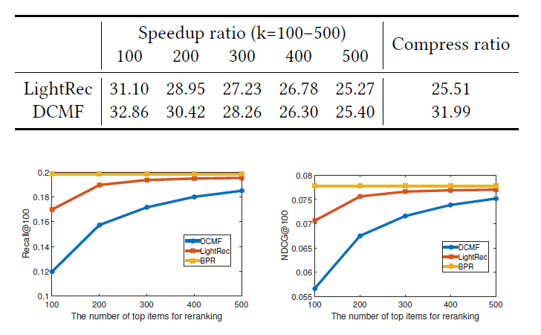
EXPERIMENT Search Efficiency
Have a better balance between accuracy and efficiency of online recommendation.
Notes:
雖然DCMF執行時間快比較多，LightRec在準確率及執行效能上取得較好的平衡

Slide 20
OUTLINE
Introduction
Method
Experiment
Conclusion

Slide 21
CONCLUSION
We propose LightRec : recurrent composite encoding
Reduce memory consumption of item representation by more than 96%.
27x speedup in top-k recommendation.
Notes:
學習一種節省空間消耗的編碼方式，且目標不影響甚至增加預測效能

